Slide 1
Oracle Autonomous Database Workshop
Joel R. Kallman
Senior Director, Software Development
Oracle Database Server Technologies
Friday, November 22nd, 2019

Slide 2
Agenda
1200 - 1300
1300 - 1400
1400 - 1415
1415 - 1630
Lunch / Registration
Oracle Autonomous Database Overview
Break
Hands On Labs

Slide 3


Joel R. Kallman
Oracle America, 1996
Based in Columbus, Ohio USA
Co-creator of Oracle APEX
Leading Oracle APEX development since 1999
Responsible for Oracle APEX development & product management
@joelkallman

Slide 4
Let’s Get Started!
http://bit.ly/APEXOCT25
bit.ly/APEXNOV22

Slide 5
DOAG Konferenz, Nürnberg, Germany, November 20

Slide 6
APEX Day, Tokyo, Japan, November 21

Slide 7
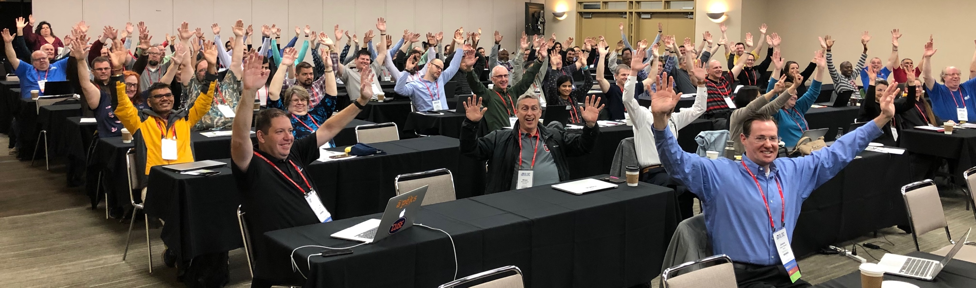
Great Lakes Oracle Conference, May 14

Slide 8


Oracle Mission Statement
“Our mission is to help people see data in new ways, discover insights, unlock endless possibilities”

Slide 9

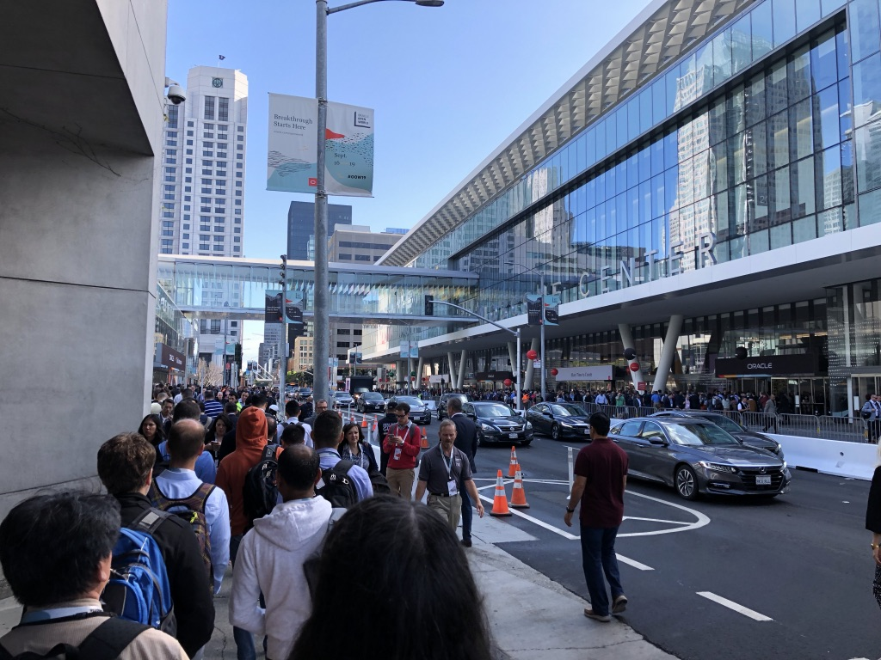
Oracle OpenWorld 2019
Notes:
For those who don’t know, Oracle OpenWorld is the annual Oracle conference held in beautiful downtown San Francisco.
There were tens of thousands of attendees from around the globe.

Slide 10
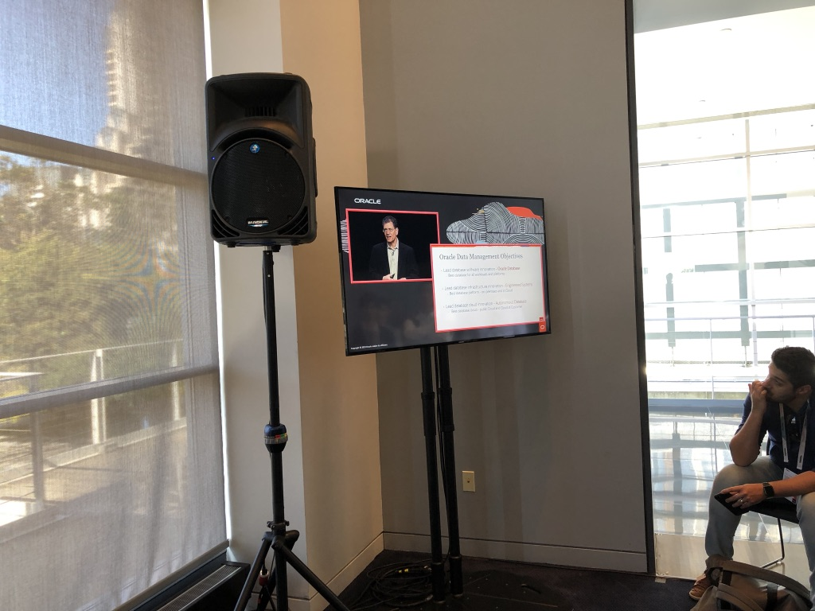
Oracle OpenWorld 2019
Notes:
And Andy Mendelsohn, the Executive Vice President of the Database division delivered his keynote address.
In past years, we were thrilled to get a bullet point on one of his slides, but instead, they did an APEX demo during his keynote. Which was great.
And you’re looking at how close I could get to the keynote. I was closed out and had to watch in a lobby.
I think the theater sat close to 1,000 people.
Enterprise Data Management and the Oracle Database is back!
So let’s get to some of the announcements.

Slide 11
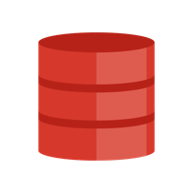


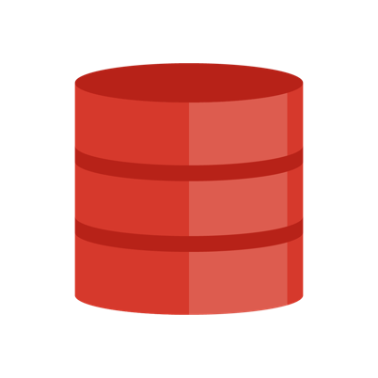
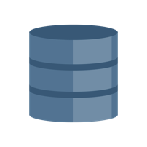
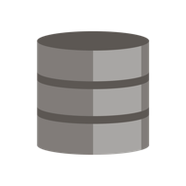




Oracle: The Converged Database
Developers get what they want…
Use popular dev tools and APIs
SQL query across all data types
Transactions across all data types
Relational
… Analysts and Ops get what they need
Consistent, queryable view of data
Powerful query and analytics
Reliability
Scalability
Security
JSON
NoSQL
Key Value
Graph
Spatial
Files

Slide 12
Oracle Data Management Objectives
Lead database software innovation - Oracle Database
Best database for all workloads and platforms
Lead database infrastructure innovation - Engineered Systems
Best database platform - on-premises and in Cloud
Lead database cloud innovation - Autonomous Database
Best database cloud - public Cloud and Cloud at Customer

Slide 13
Oracle Data Management Objectives
Lead database software innovation - Oracle Database
Best database for all workloads and platforms
Lead database infrastructure innovation - Engineered Systems
Best database platform - on-premises and in Cloud
Lead database cloud innovation - Autonomous Database
Best database cloud - public Cloud and Cloud at Customer

Slide 14
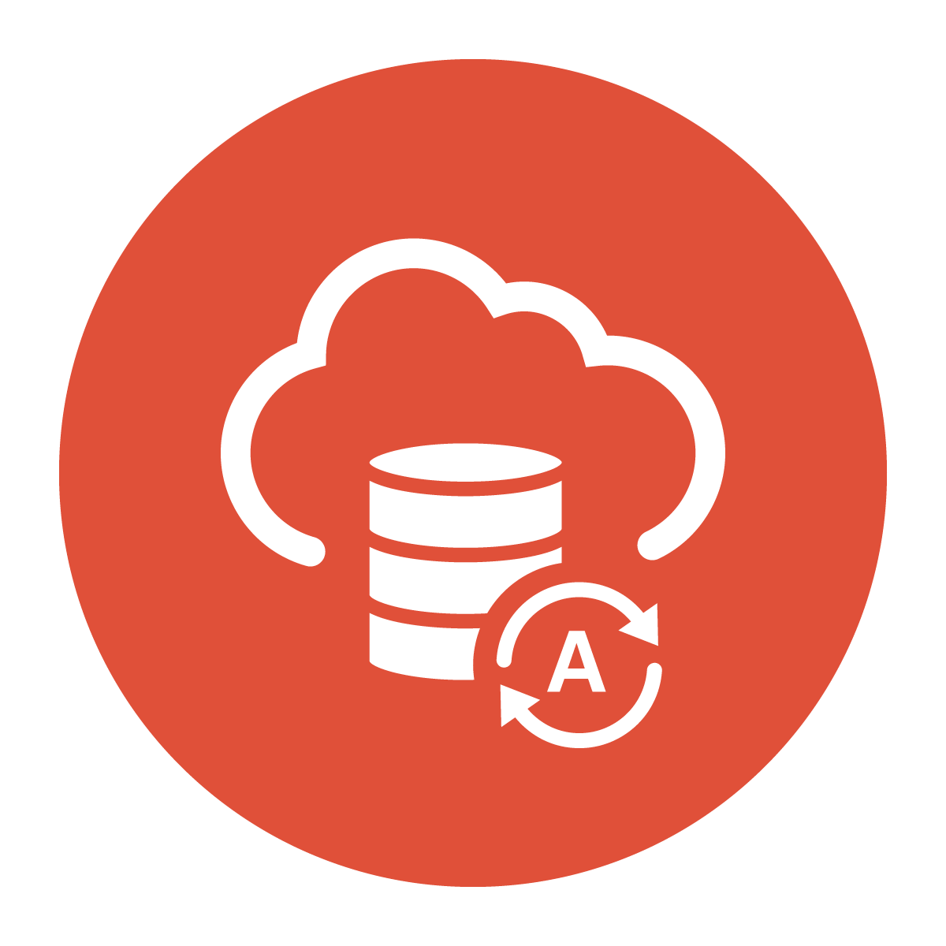
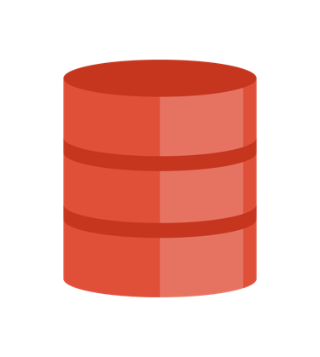
Oracle Autonomous Database
Oracle Cloud
Complete Infrastructure Automation
Complete Database Automation
Automated Data Center Operations and Machine Learning
Autonomous Database
Copyright © 2019 Oracle and/or its affiliates.
Notes:
We have been on this journey for over 20 years. Starting in Oracle Database 9i we began to introduced and matured many sophisticated automation capabilities from memory management to workload monitoring and tuning, all of which are used in the autonomous database. But it’s not just the database management that Oracle has been automating
We have also spent the last decade working on the database infrastructure with our engineered systems, which provide the best platform for the oracle database as they are
the only pre-configured, pre-tested and optimized platforms for the database.
The Oracle Cloud allows us to complete the journey to the autonomous database as it is the integration of our complete infrastructure automation with Oracle Database , and our fully automated data center operations. Automated data center operations include:
Provisioning, Patching, upgrading, and online
back ups Monitoring, scaling, diagnosing performance, tuning, optimizing
Testing and change management of complex applications and workloads
Automatically handling failures and errors
Brings full automation to entire database lifecycle

Slide 15
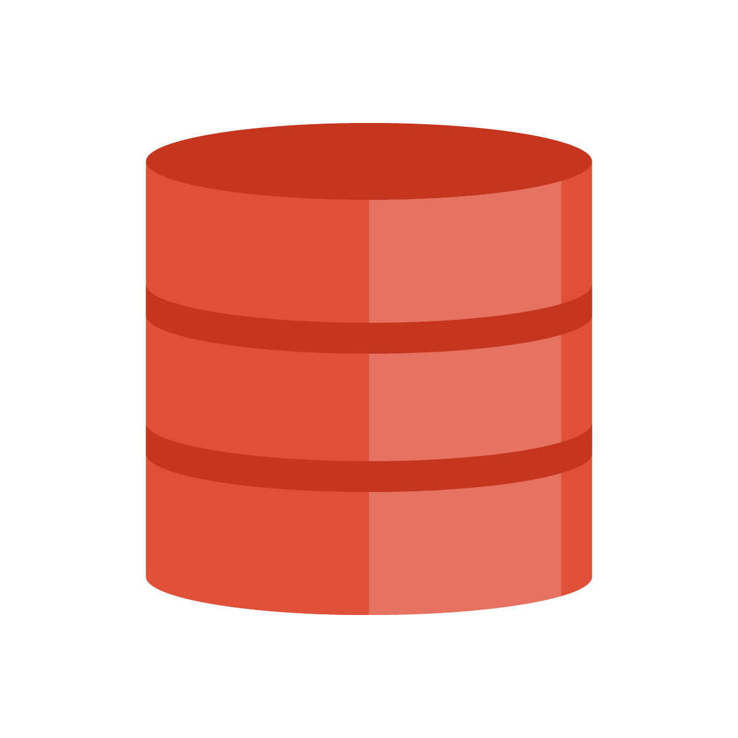


Autonomous Database Machine Learning
Database
Infrastructure
Database
Operations
Workload
Optimizations
Detection and recovery of failed/sick server, storage or switch/link
Hang Management
Anomaly Detection
Maintenance Slot Identification
Bug Identification and Prioritization
Query Optimizer
Real-time statistics
Automatic Indexing

Slide 16
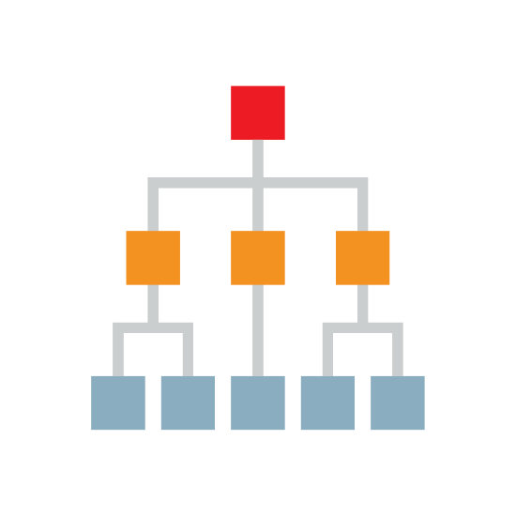
New | Automatic Indexing
Self-tuning for transactional and mixed workloads
Or use in advisory mode for existing workloads
Machine Learning continuous monitoring
Captures all SQL statements
Identifies new SQL plans and indexes
Changes tested outside of production
Then validated on first execution
All auditable by customer
Capture
Identify
Verify
Decide
Monitor

Slide 17
Two Deployment Choices
ORACLE AUTONOMOUS DATABASE
Serverless
Dedicated
Ultra-Simple and Elastic
Customizable Private Database Cloud in Public Cloud
Data-Driven Results Fast
LOB, Dept, SMB Developer, Data Scientist
Rethink Database I.T.
CIO, CTO,
Architect, DBA
Copyright © 2019 Oracle and/or its affiliates.
Notes:
Serverless
Simple
Oracle automates and manages everything
Deployment, lifecycle, software updates, etc.
Customer just chooses database compute, storage, and region
Elastic
Low minimum size - 1 OCPU
Low minimum time commitment - 1 hour
Automatically scales online for true pay-per-use
Any workload or Mix of Workloads Any Scale
Dedicated
Provides your own Database Cloud running on dedicated Exadata Infrastructure
Runs “all” your databases - any size, scale, or criticality
Consolidation, Cloud Transformation, Database as a service
Highest Isolation
Runs inside Secure Isolation Zone for highest protection from other tenants
Configure multiple Exadatas or Container Databases for intra-company isolation
Customizable Operational Policies
Control of provisioning, updates, availability, densit

Slide 18
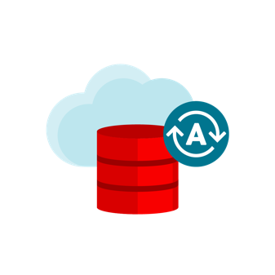

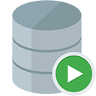

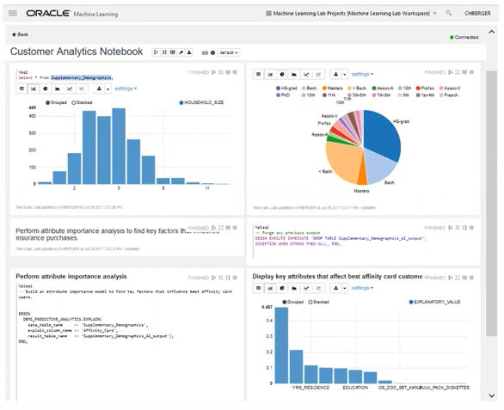
Autonomous Database – Integrated Tools
APEX & ORDS
Rapid Database Application Development
SQL Developer Web
Data Modeling and SQL Development
Machine Learning Notebooks
Drag and Drop Analytic Dashboards
Performance Hub & Service Console
Real Time Database Monitoring
Ultimate in Productivity for Developers, Data Scientists, DBAs
Copyright © 2019 Oracle and/or its affiliates.

Slide 19
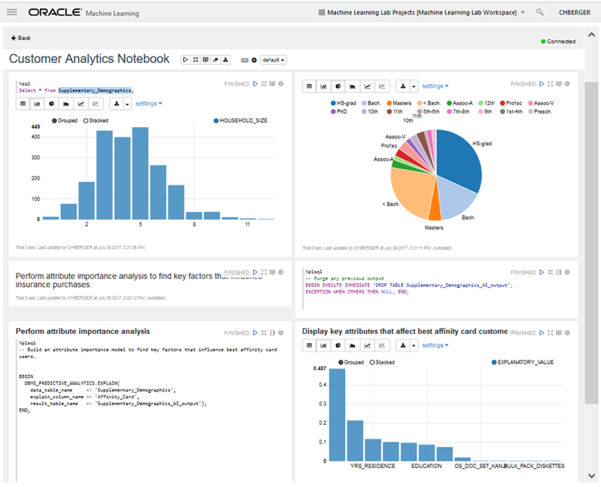
Oracle Machine Learning Notebooks
Autonomous Database + Machine Learning Platform
Collaborative UI
Based on Apache Zeppelin
Supports data scientists, data analysts, application developers, DBAs
Easy sharing of notebooks and templates
Permissions, versioning, and execution scheduling
Included with Autonomous Database
Automatically provisioned, managed, backed up
In-database SQL algorithms and analytics functions
Supports deployment of ML analytics via ORDS (Oracle REST Data Services)
Soon to be augmented with Python and R
Copyright © 2019 Oracle and/or its affiliates.

Slide 20
What is included with Autonomous Database?
Exadata
Real Application Clusters (RAC)
Active Data Guard
Multitenant
Partitioning
Advanced Compression
Advanced Security
Label Security
Database Vault
OLAP
Advanced Analytics
Spatial and Graph
Data Masking and Subsetting Pack
Diagnostics Pack
Tuning Pack
Database Lifecycle Management Pack

Slide 21
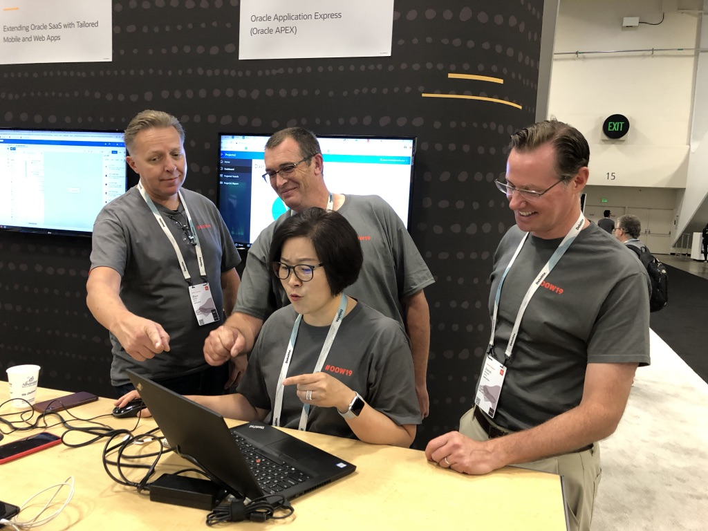
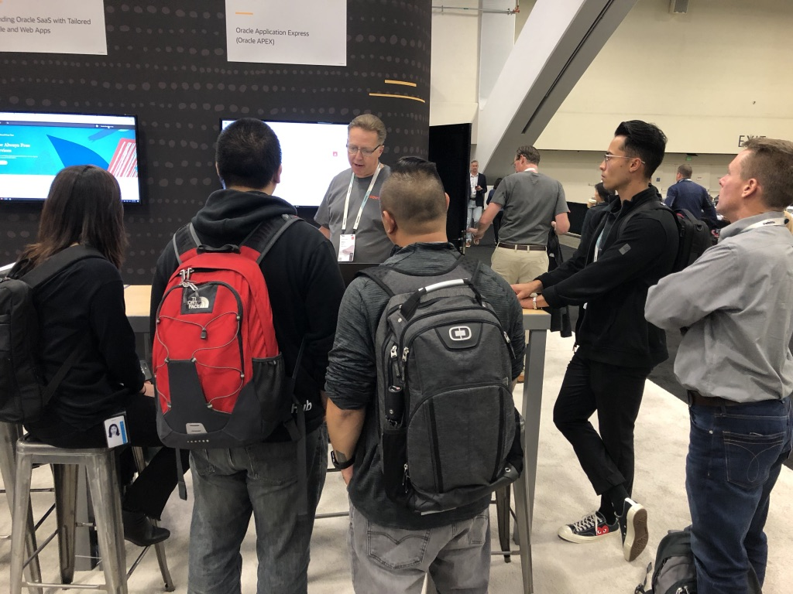
APEX @ Oracle OpenWorld 2019
Notes:
There was a lot of APEX at Oracle OpenWorld
Not only did we have our demo area (now called “The Exchange”) which was busy throughout the conference
14 APEX related conference session, which for OOW isn’t bad.
4 Hands On Labs
Numerous “Zip Labs” and Drop-in Labs
I saw the first APEX-branded booth at Oracle OpenWorld, that was from Database Consulting from Poland.

Slide 22
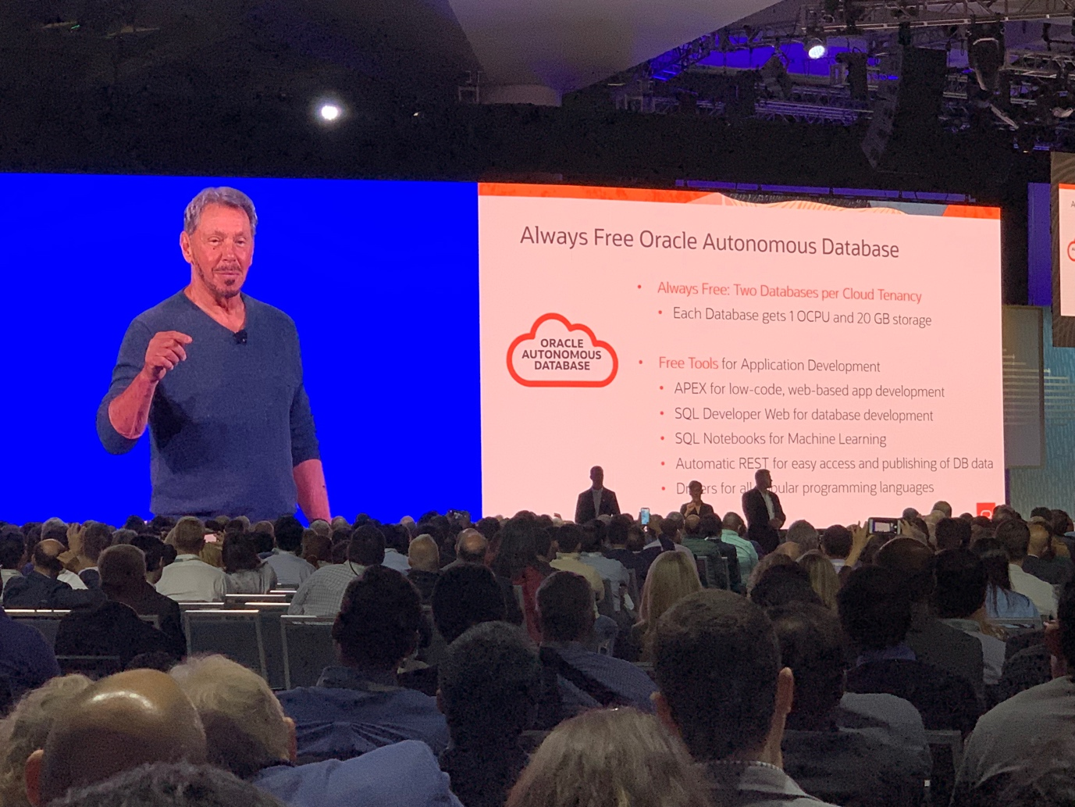
Always Free | Announced at Oracle World 2019
APEX for low code App Development
SQL Developer Web for DB Development
SQL Notebooks for Machine Learning (Zeppelin Notebooks)
Automatic REST for easy access and publishing of Database data (ORDS)
Drivers for all popular programming languages
Monday September 16th, 2019

Slide 23
New – Free Tier for Oracle Cloud
Autonomous Database
Compute
Storage
Networking/ Load Balancing
Monitoring / Notifications
2 x Databases
20 GB each
Supports ATP & ADW
2 x VMs
1 GB Memory each
100 GB Block
10 GB Object
10 GB Archive
10 Mbps LB
10 TB Outbound Data Transfer
500M Metrics Ingestion 1B Metrics Retrieval
1M Notifications
1K Emails
Available to all new and existing cloud accounts
Notes:
This was *THE* big announcement for us at OOW.
As you know, we have offered apex.oracle.com on the Internet since 2002. You make it easy for people to try your technology, and they will come. We get 3,000 people a week today sign up on apex.oracle.com.
But apex.oracle.com is limited. And it’s not ”real” Cloud. This is real.
The Free Tier is perpetually free. Free for as long as you use it.
I don’t believe there is anything preventing someone from deploying their production apps there. Obviously, no SLA. No Support. But it’s free, as in beer.
And in the past, Oracle may have been a bit miserly when it comes to letting people use our technology for free.
The original Database XE (the free version of Oracle) was stripped down. The latest XE is full featured.
This Autonomous Database is full featured, and includes countless options.
As Larry Ellison said – this is our best stuff. It’s not stripped down.
I see this as a huge enabler for the APEX community, for new developers, for hobbyists, for user groups, for meetup groups, for anyone.

Slide 24
Dimitri Gielis blog posts on Free Cloud
1. Sign-up for Free Oracle Cloud
2. Setup Autonomous Transaction Cloud (ATP)
3. Connecting with SQL Developer (Desktop) to ATP
4. Connecting with SQL Developer Web to ATP
5. Setup APEX in ATP and create the first APEX app
6. Create a VM Instance (Compute Cloud)
7. Setup a Webserver on the Compute Instance (VM)
8. Setup APEX Office Print (AOP) to export to PDF, Excel, Word, Powerpoint, HTML and Text
9. Setup Object Storage and use for File Share and Backups
10. Running SQLcl and Datapump from the Compute Instance (VM) to ATP
11. Sending Emails with APEX_MAIL on ATP
12. Create a 2nd Compute Instance and a Load Balancer
13. Final things to take away
14. Message: Your Oracle Cloud Free Trial has expired (but FREE keeps running)
15. Error: The request could not be mapped to any database

Slide 25
Oracle Cloud Free Tier
oracle.com/free
Notes:
You can go to this URL to learn more and sign up for the Oracle Cloud Free Tier

Slide 26
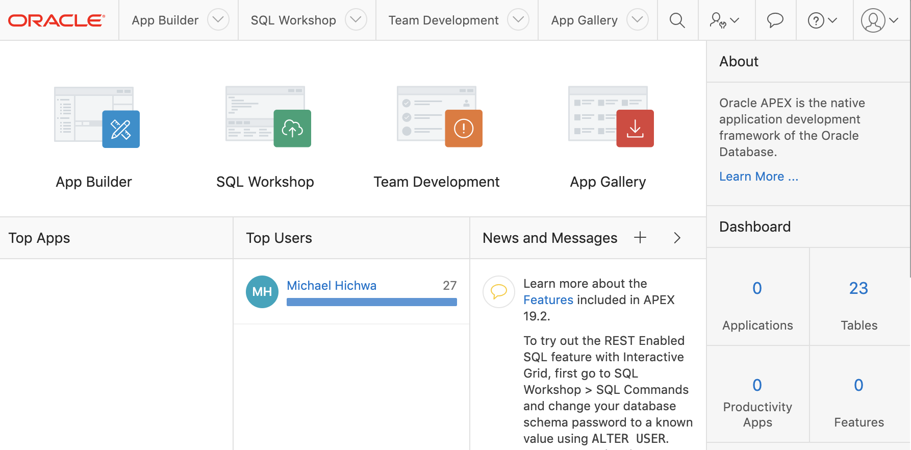
Oracle APEX | on Always Free Autonomous Database
Once logged into APEX it is the same experience as on prem

Slide 27
New | APEX on Autonomous Database
VS.
APEX on Autonomous
Declarative
Few lines of code
Robust
Secure by default
JavaScript on AWS
Hand coding
Lots and lots of code
Complex to maintain and diagnose
Security coded by each developer
20X faster to develop
100X fewer lines of code

Slide 28
Low Code | vs Traditional Coding
“10 times faster than traditional methods”
https://go.forrester.com/blogs/why-you-need-to-know-about-low-code-even-if-youre-not-responsible-for-software-delivery/
“Create, iterate, and release applications in a fraction of the time”
https://www.mendix.com/low-code-guide/
“By 2024, low-code application development will be responsible for more than 65% of application development activity. ”
reference: Low-Code Development Technologies Evaluation Guide Published 26 February 2019, Gartner
“…compelling productivity gains for professional and citizen development, as well as speed-of-delivery benefits.”
https://www.gartner.com/en/documents/3956079/magic-quadrant-for-enterprise-low-code-application-platf

Slide 29
Oracle APEX 19.2

Slide 30
Lab 1: Application on a Spreadsheet
http://bit.ly/APEXOCT25Lab1
bit.ly/APEXNOV22Lab1

Slide 31
Lab 2: Add Machine Learning to APEX
http://bit.ly/APEXOCT25Lab1
bit.ly/APEXNOV22Lab2
Video

Slide 32
Lab 3: Add Spatial to APEX
http://bit.ly/APEXOCT25Lab1
bit.ly/APEXNOV22Lab3
Video

Slide 33
Lab 3: Application
http://bit.ly/APEXOCT25Lab1
bit.ly/APEXLab3App
Video

Slide 34
All Labs
http://bit.ly/APEXOCT25Lab1
bit.ly/APEXNOV22Labs

Slide 35
To access your account, go to cloud.oracle.com

